Slide 1

PRESENTATION
CNN
Auto-Encoder
Vision Transformer
52100674 - Trần Thị Vẹn
52000025 - Nghiêm Tiến Đạt

Slide 2
Convolutional Neural Network (CNN)

Slide 3
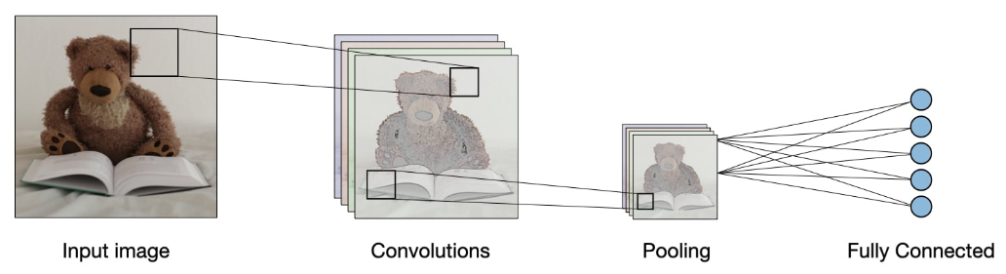
Overview
Convolutional neural networks, also known as CNNs, are a specific type of neural networks that are generally composed of the following layers:

Slide 4
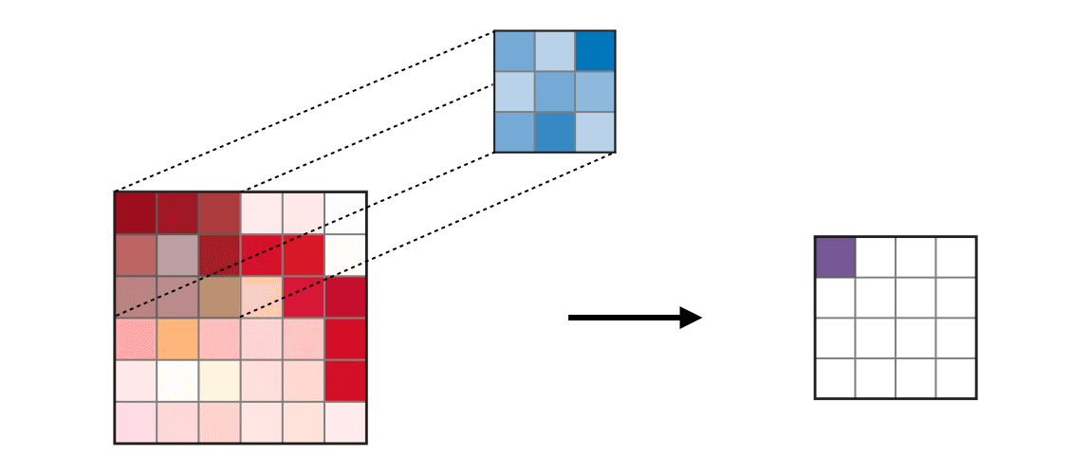
1. Type of layers
Convolution Layer (CONV)
The convolution layer (CONV) uses filters that perform convolution operations as it is scanning the input I with respect to its dimensions. Its hyperparameters include the filter size F and stride S. The resulting output O is called feature map or activation map.
F
I
O

Slide 5
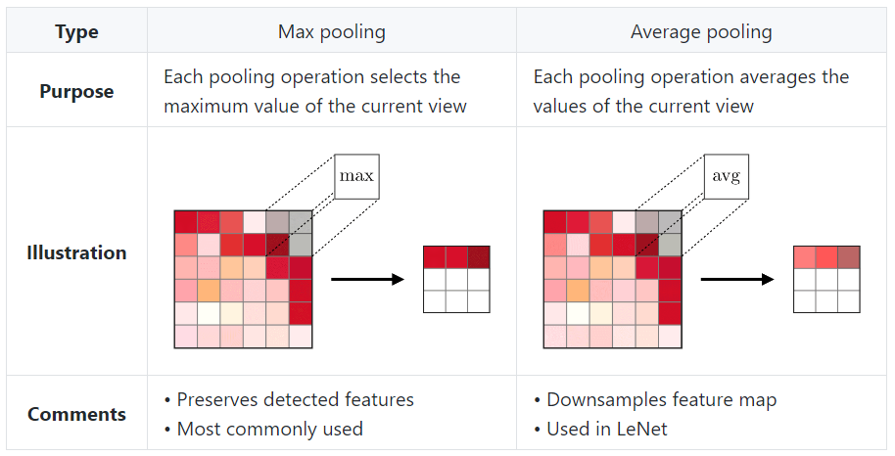
1. Type of layers
Pooling (POOL)
The pooling layer (POOL) is a downsampling operation, typically applied after a convolution layer, which does some spatial invariance. In particular, max and average pooling are special kinds of pooling where the maximum and average value is taken, respectively.

Slide 6
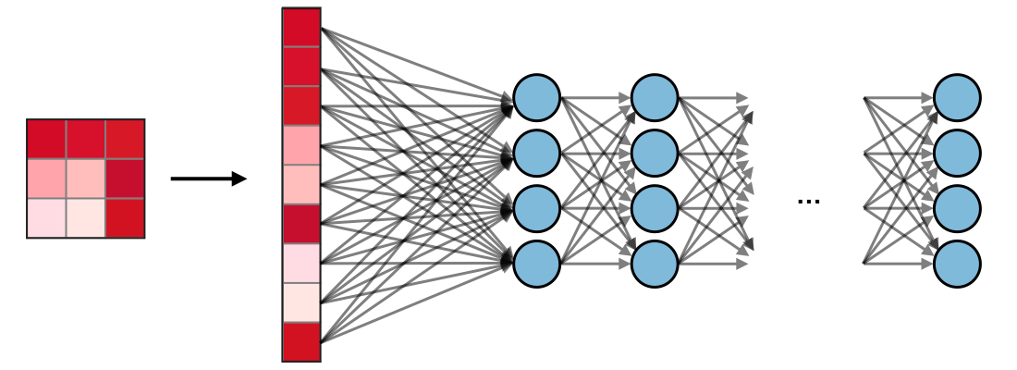
1. Type of layers
Fully Connected (FC)
The fully connected layer (FC) operates on a flattened input where each input is connected to all neurons. If present, FC layers are usually found towards the end of CNN architectures and can be used to optimize objectives such as class scores.

Slide 7
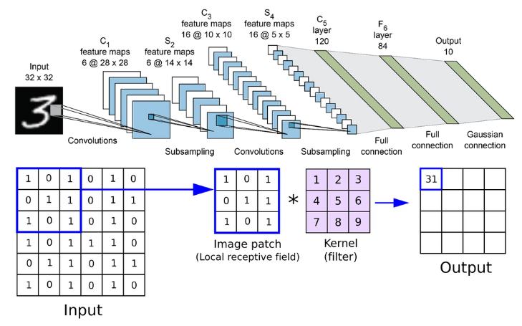

Slide 8
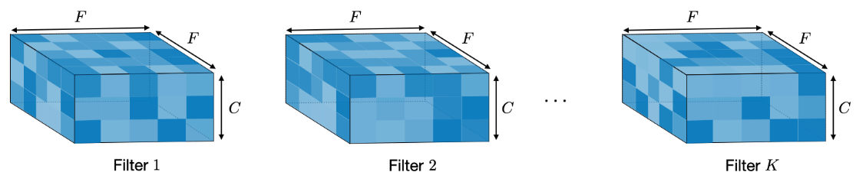
2. Filter hyperparameters
Dimensions of a filter
A filter of size F×F applied to an input containing C channels is a F×F×C volume that performs convolutions on an input of size I×I×C and produces an output feature map (also called activation map) of size O×O×1.
Remark: the application of K filters of size F×F results in an output feature map of size O×O×K.

Slide 9
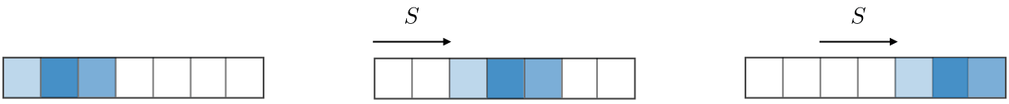
2. Filter hyperparameters
Stride
For a convolutional or a pooling operation, the stride S denotes the number of pixels by which the window moves after each operation.
Zero-padding
Zero-padding denotes the process of adding P zeroes to each side of the boundaries of the input. This value can either be manually specified or automatically set through one of the three modes detailed below:
Valid
Same
Full

Slide 10
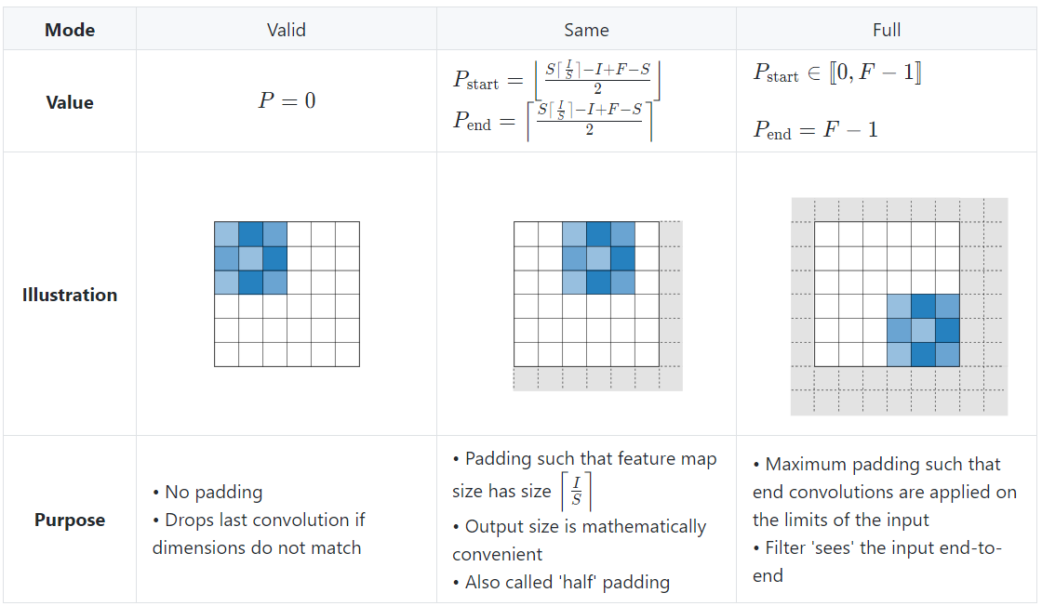
2. Filter hyperparameters
Zero-padding

Slide 11
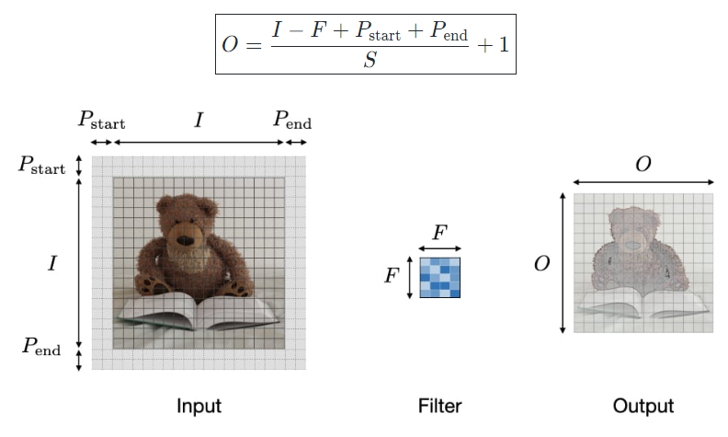
2. Filter hyperparameters
Zero-padding
By noting I the length of the input volume size, F the length of the filter, P the amount of zero padding, S the stride, then the output size O of the feature map along that dimension is given by:

Slide 12
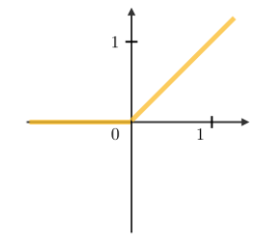
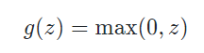
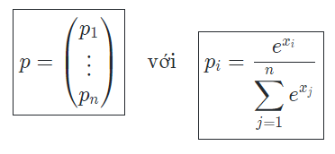
3. Commonly used activation functions
Rectified Linear Unit (ReLU)
The rectified linear unit layer (ReLU) is an activation function g that is used on all elements of the volume. It aims at introducing non-linearities to the network.
Softmax
The softmax step can be seen as a generalized logistic function that takes as input a vector of scores x and outputs a vector of output probability p through a softmax function at the end of the architecture.

Slide 13

4. CNN applications
Classify a picture
Predict probability of object
Be a fundamental architectural component of other models

Slide 14
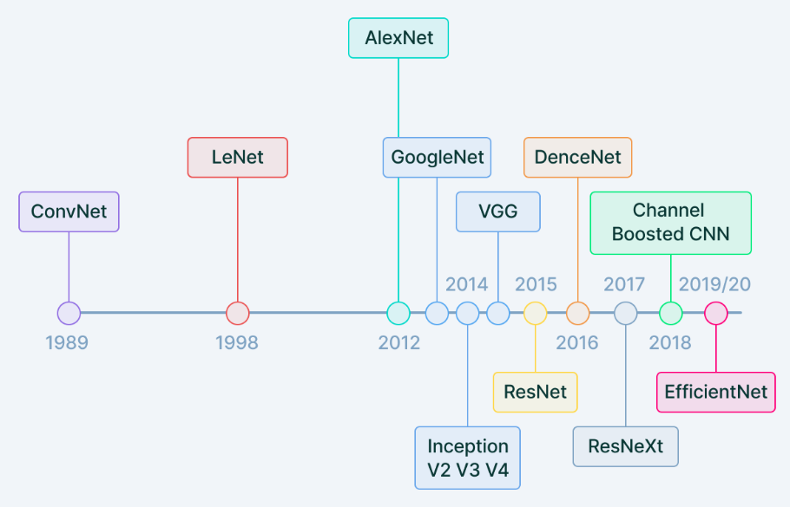
5. History of CNN

Slide 15
Auto-Encoder

Slide 16
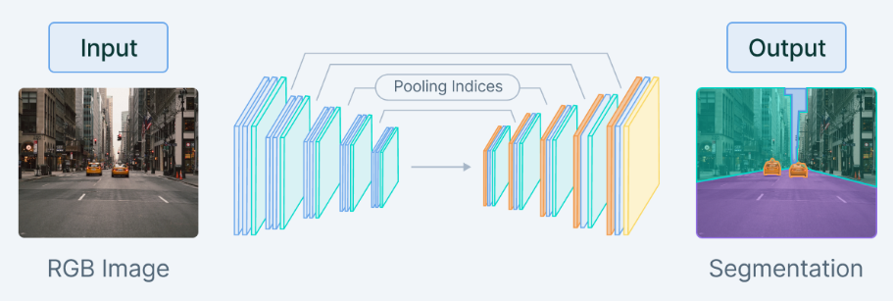
1. What is an autoencoder?
An autoencoder is a type of artificial neural network used to learn data encodings in an unsupervised manner.
The aim of an autoencoder is to learn a lower-dimensional representation (encoding) for a higher-dimensional data, typically for dimensionality reduction, by training the network to capture the most important parts of the input image.

Slide 17
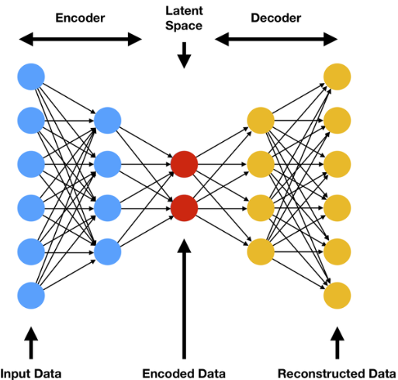
2. The architecture of autoencoders
Encoder
The encoder is a set of convolutional blocks followed by pooling modules that compress the input to the model into a compact section called the bottleneck.
Bottleneck
The bottleneck exists to restrict the flow of information to the decoder from the encoder, thus, allowing only the most vital information to pass through.
Decoder
The decoder is a set of upsampling and convolutional blocks that reconstructs the bottleneck's output.

Slide 18
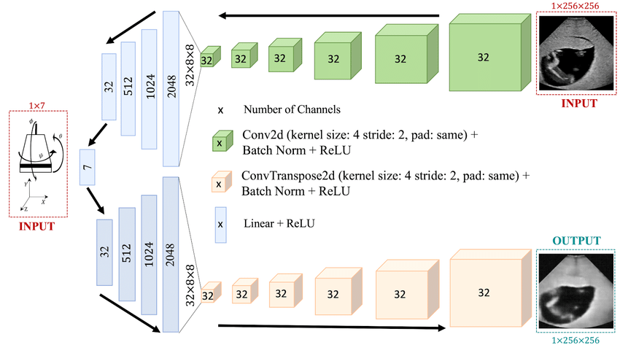
3. Autoencoder hyperparameters
Code size: The code size or the size of the bottleneck, decide how much the data has to be compressed.
Number of layers
Number of nodes per layer
Reconstruction Loss: The loss function we use to train the autoencoder, the most popular loss functions for reconstruction are MSE Loss and L1 Loss.

Slide 19
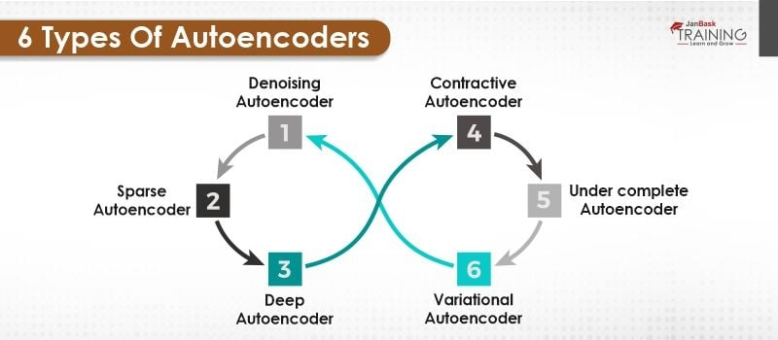
4. Six types of autoencoders

Slide 20
4. Six types of autoencoders
1. Undercomplete autoencoder
is one of the simple types of autoencoders.
takes in an image and tries to predict the same image as output, thus reconstructing the image from the compressed bottleneck region.
2. Sparse autoencoder
is similar to the undercomplete autoencoders in that they use the same image as input and ground truth.
Undercomplete
Sparse
is regulated and fine-tuned by regulating the size of the bottleneck.
is regulated by changing the number of nodes at each hidden layer.

Slide 21
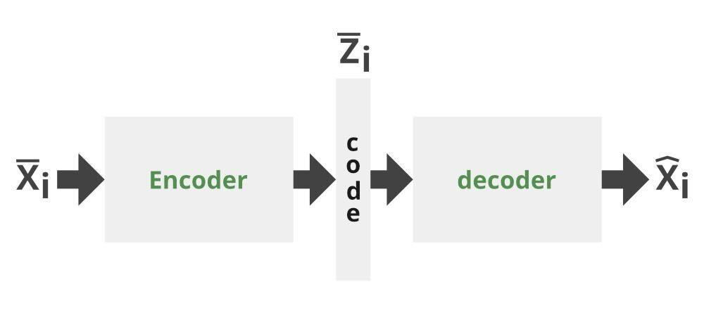
4. Six types of autoencoders
3. Contractive autoencoder
has a regularization term to prevent the network from learning the identity function and mapping input into the output.
work on the basis that similar inputs should have similar encodings and a similar latent space representation. It means that the latent space should not vary by a huge amount for minor variations in the input.

Slide 22
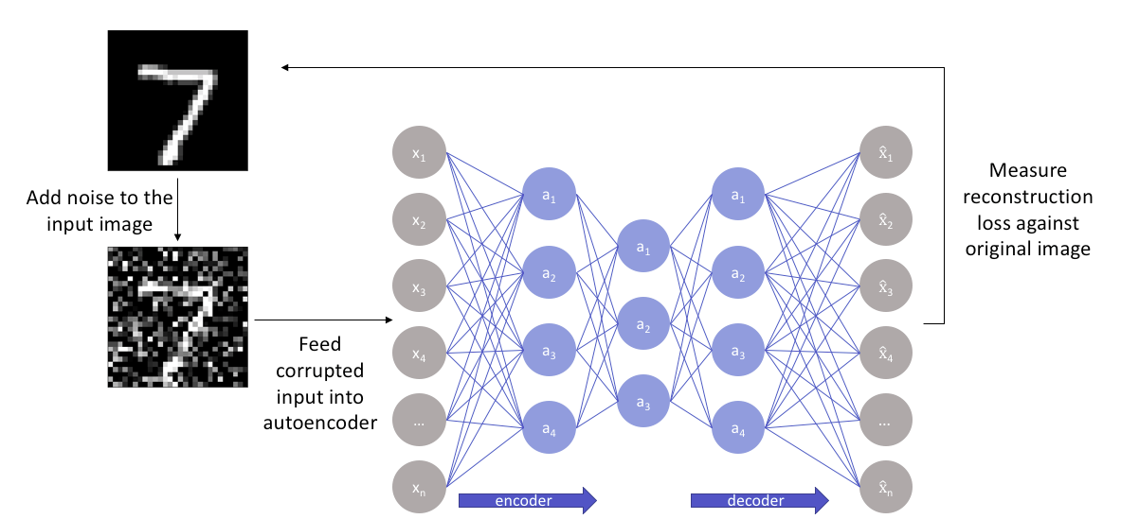
4. Six types of autoencoders
4. Denoising autoencoder

Slide 23
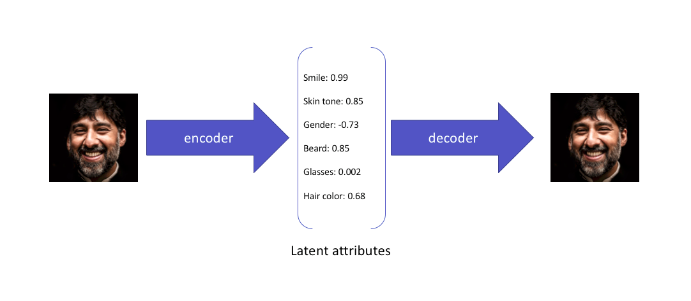
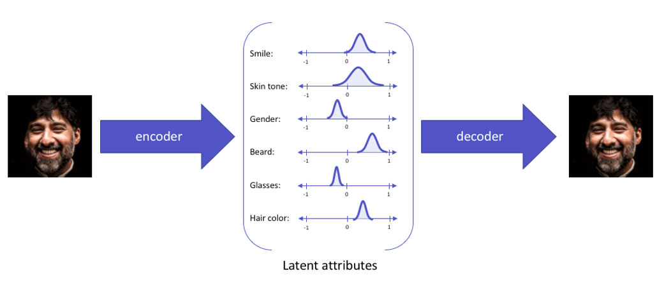
4. Six types of autoencoders
5. Variational autoencoder
Standard autoencoders do not allow the latent attributes to be expressed in a probabilistic fashion.
Variational autoencoders express their latent attributes as a probability distribution → continuous latent space that can be easily sampled and interpolated.

Slide 24
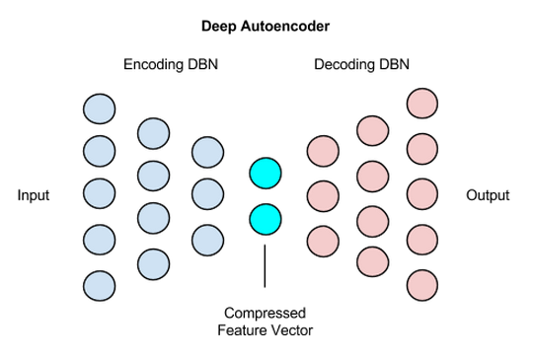
4. Six types of autoencoders
6. Deep Autoencoder
A deep autoencoder is composed of two, symmetrical deep-belief networks that typically have four or five shallow layers representing the encoding half of the net, and second set of four or five layers that make up the decoding half.

Slide 25
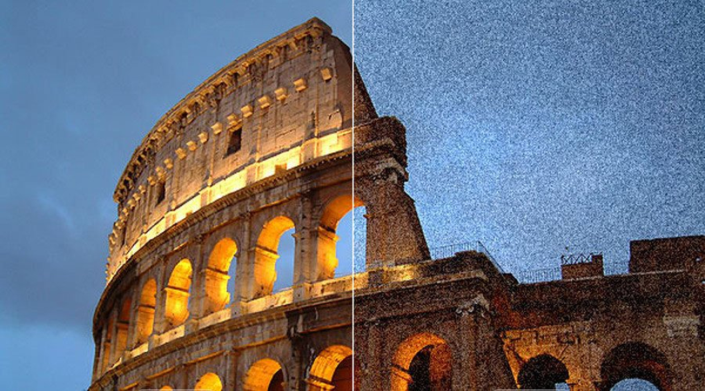
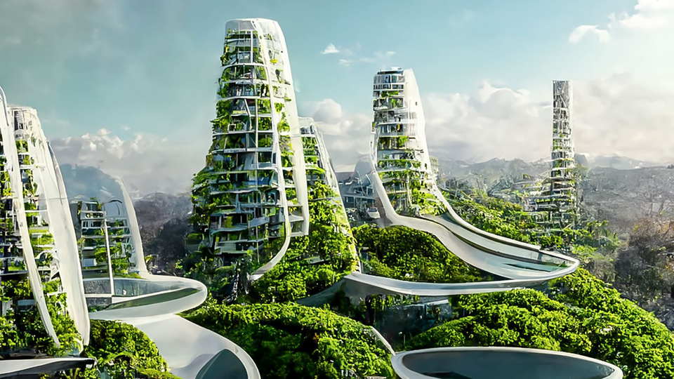
5. Applications
1. Dimensionality reduction
2. Image denoising
3. Generation of images data
4. Anomaly detection

Slide 26
5. Pros and Cons
Benefits
Drawbacks
are flexible and adaptable to different types of data and tasks.
can learn complex or abstract features that other methods may miss.
can also be customized depending on the goal and the challenge of the data.
are computationally expensive.
require more time and resources to train and tune than other methods.
are sensitive to the choice of hyperparameters which can affect the performance and the quality of the autoencoder.

Slide 27
Vision Transformer

Slide 28
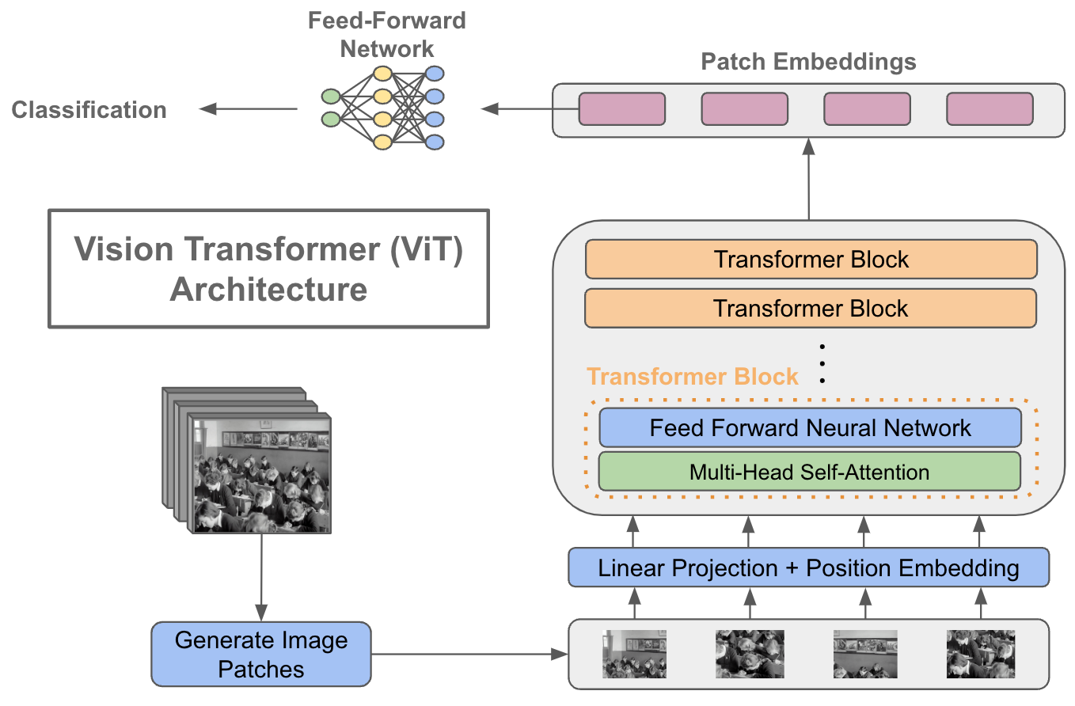

Slide 29
Vision transformer
Lớp Multi-Head Self Attention: nối tất cả các kết quả đầu ra của Cơ chế Attention một cách tuyến tính theo đúng kích thước.
Lớp Multi-Layer Perceptrons (MLP): Lớp này chứa một hàm Gaussian Error Linear Unit hai lớp.
Lớp thường: nó không bao gồm bất kỳ yếu tố phụ thuộc mới nào giữa các hình ảnh huấn luyện. Điều này giúp cải thiện thời gian đào tạo và hiệu suất tổng thể.

Slide 30
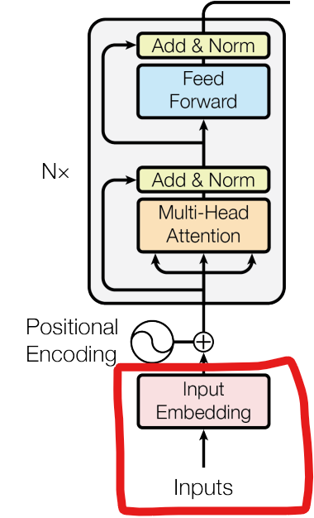
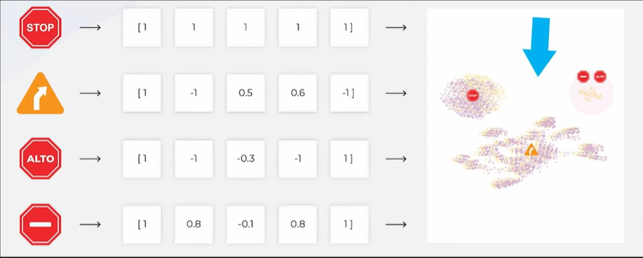
Vision transformer

Slide 31
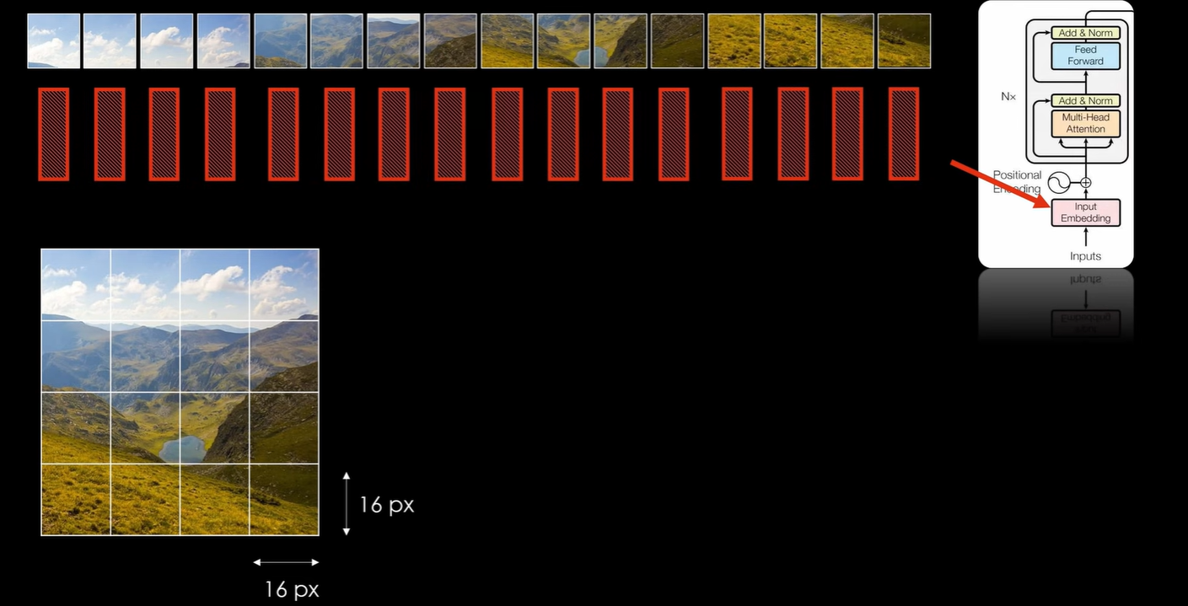
Vision transformer
Chia hình ảnh thành các mảng (patch) với kích thước từng mảng cố định
Làm phẳng các mảng hình ảnh
Tạo các feature embedding có chiều thấp hơn từ các mảng hình ảnh phẳng này

Slide 32
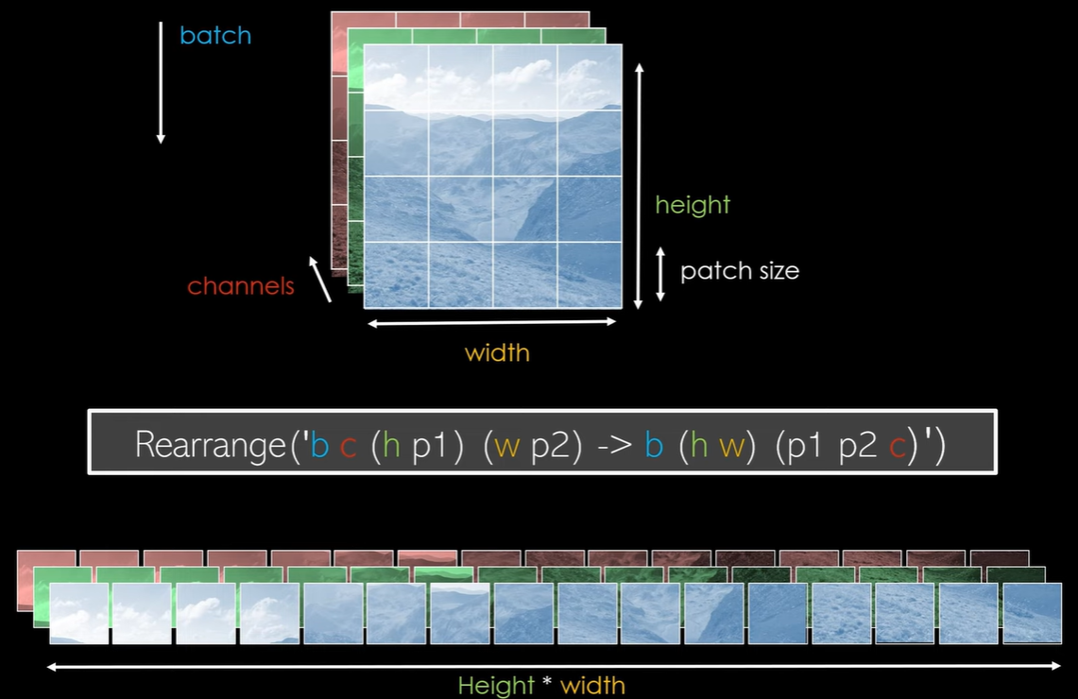

Slide 33
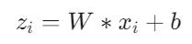
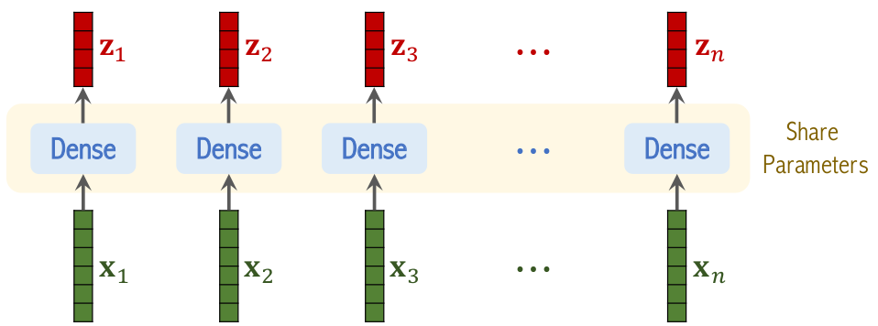
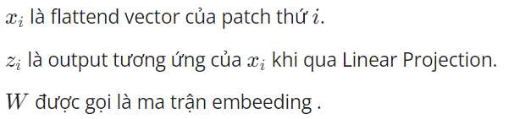
Vision transformer
Đưa các patches này về dạng vector bằng cách flattend các patches này ra.
Thực chất Linear Projection là một lớp Dense với đầu vào là flattend vector của các patches, đầu ra sẽ là embeeding vector tương ứng với từng patch.

Slide 34
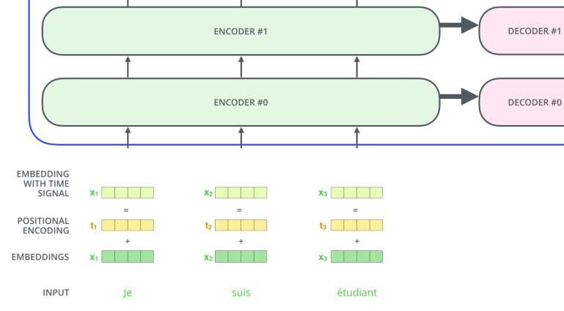
Vision transformer
Positional Encoding
Tất cả các vector vào mạng cùng 1 lúc, song song
Cần một cơ chế để ”note” lại vị trí các từ trong câu
Vector PE tham gia cuộc chơi (size = word embedding)

Slide 35
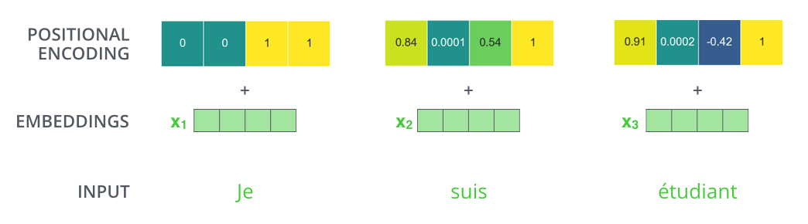
Vision transformer

Slide 36
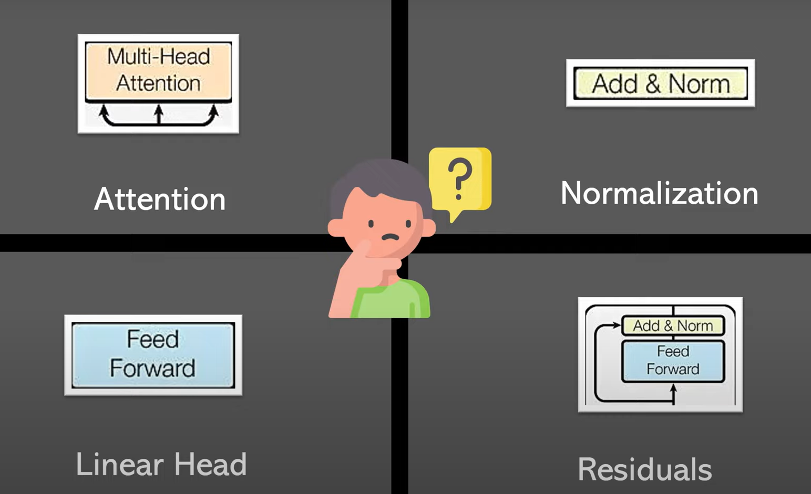
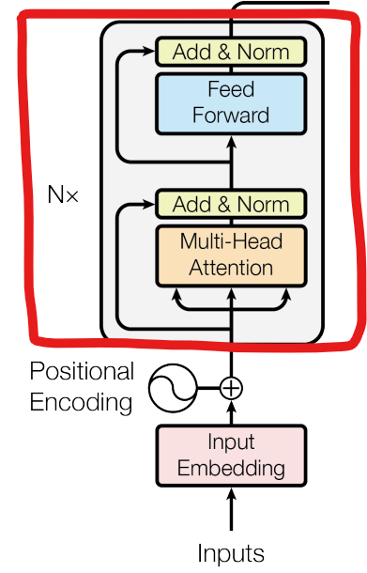
Vision transformer

Slide 37
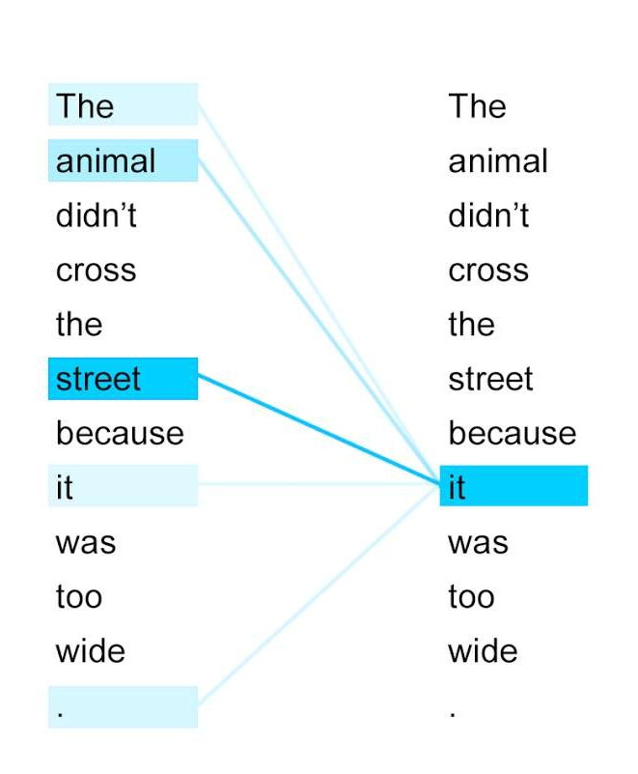
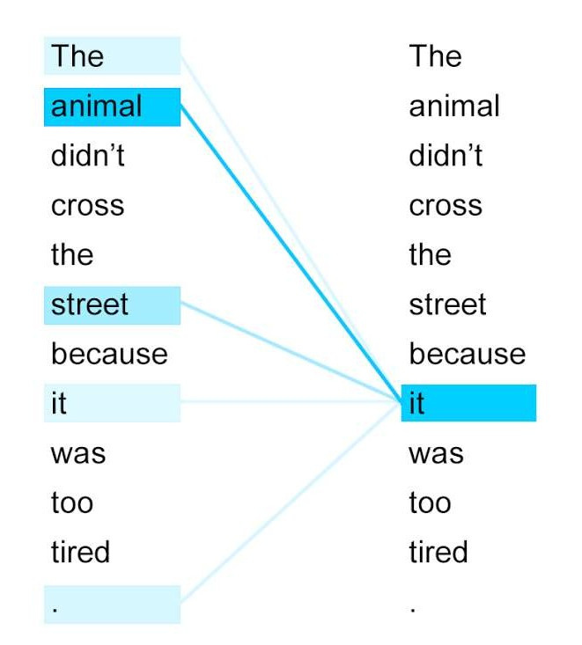
Vision transformer
Self Attention
Tạo ra quan hệ giữa các từ trong câu
Khi được mã hoá (encode) nó sẽ mang
thêm thông tin của các từ liên quan

Slide 38

Vision transformer

Slide 39

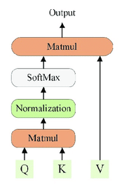
Vision transformer

Slide 40
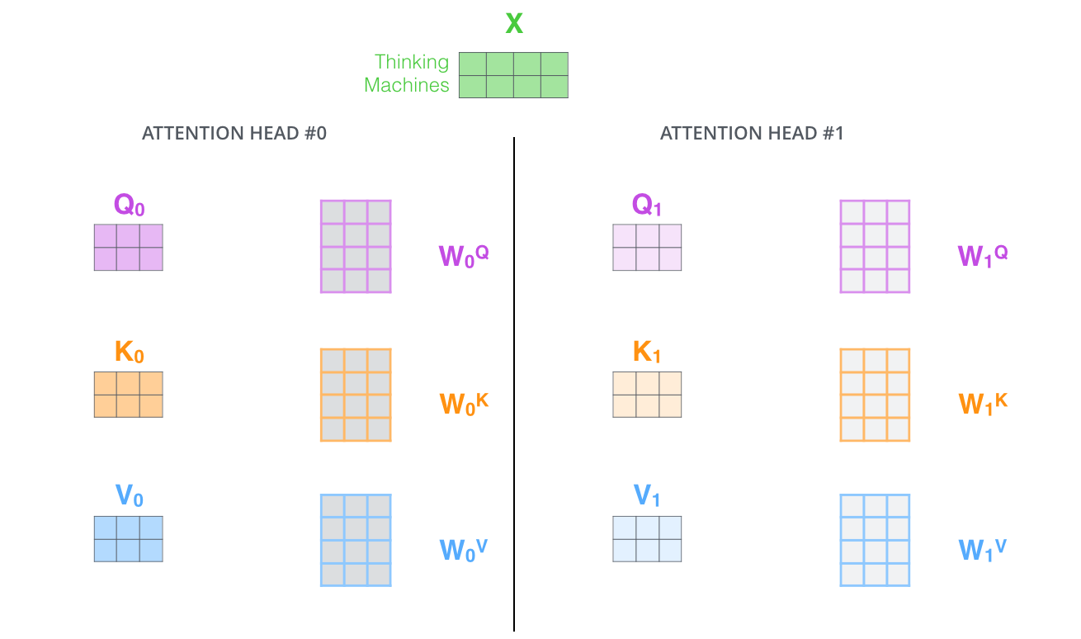
Vision transformer
Multi-head

Slide 41
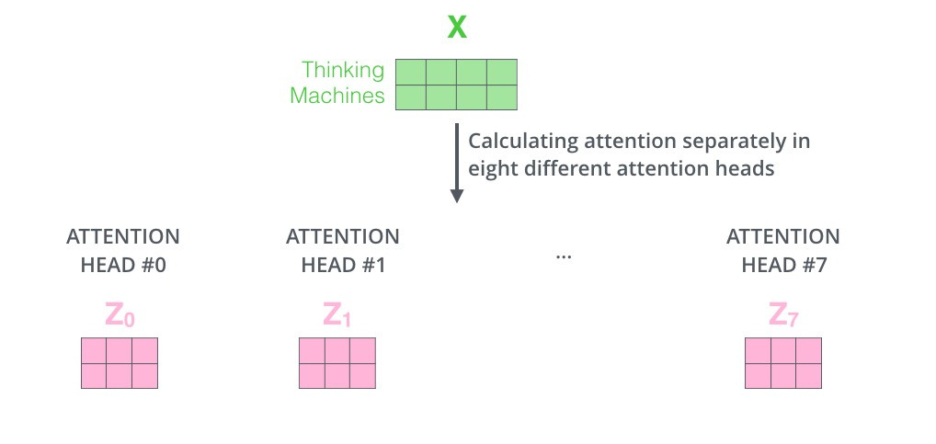
Vision transformer

Slide 42
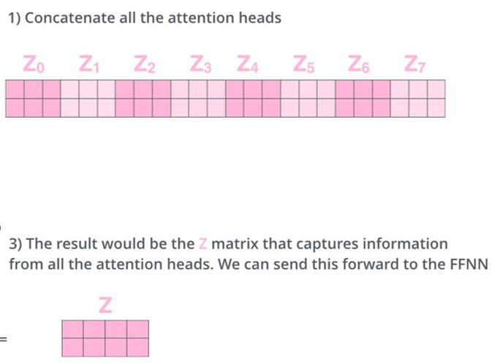
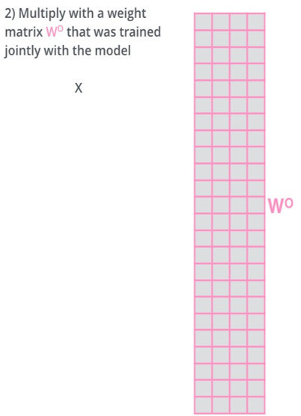
Vision transformer
Multi-head

Slide 43
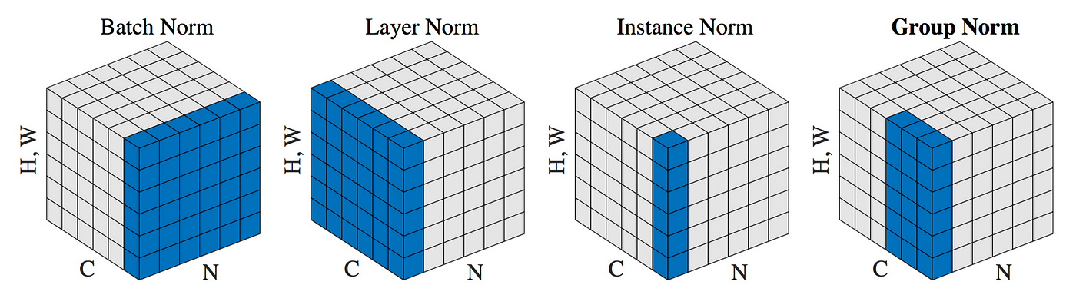
Vision transformer
Normalization

Slide 44
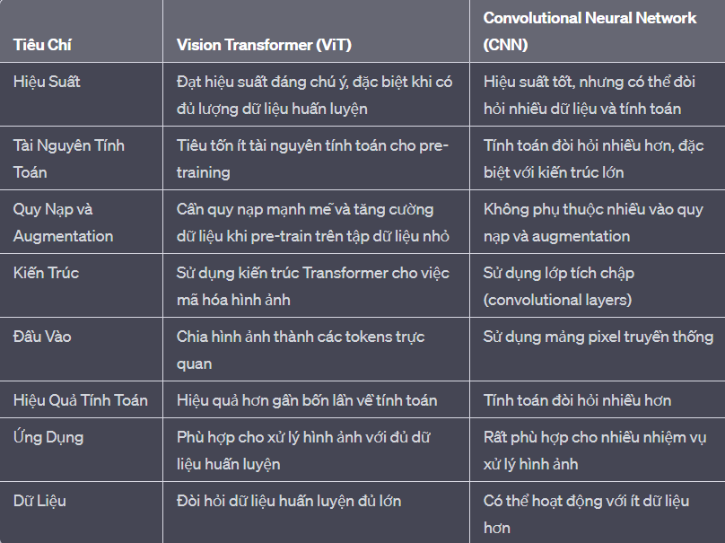
Vision transformer và CNN

Slide 45
Ứng dụng Vision Transformer
+ Phát hiện và nhận dạng đối tượng: áp dụng trong các lĩnh vực như an ninh, nhận dạng khuôn mặt, và kiểm tra hàng hóa.
+ Xử lý ảnh y tế: xử lý và phân tích hình ảnh y tế, như phát hiện bệnh, phân đoạn cơ quan nội soi.
+ Xử lý ảnh trong xe tự lái: xe tự lái hiểu và tương tác với môi trường xung quanh, phát hiện biển báo giao thông, và nhận dạng các phương tiện khác trên đường.
+ Quảng cáo và phát sóng trực tiếp: tối ưu hóa việc hiển thị quảng cáo dựa trên phân tích hình ảnh của người xem, cung cấp trải nghiệm cá nhân hóa.

Slide 46
DEMO autoencoder
Mục tiêu:
Basic autoencoder: ảnh đầu vào  nén ảnh  tái tạo lại ảnh
Denoising autoencoder: ảnh nhiễu  khử nhiễu  ảnh giảm nhiễu
Tập dữ liệu: Fashion MNIST gồm 70,000 ảnh xám kích thước 28 × 28 pixels về trang phục (quần , áo, giày, dép, v.v.)
Link: demo autoencoder

Slide 47
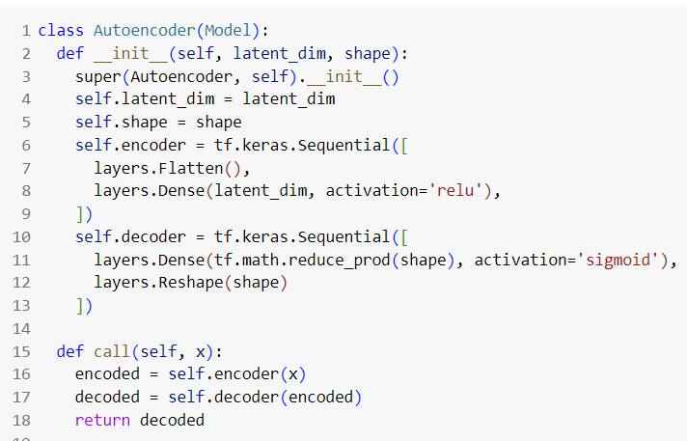
DEMO autoencoder
Basic Autoencoder
Cấu trúc

Slide 48
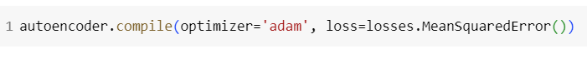
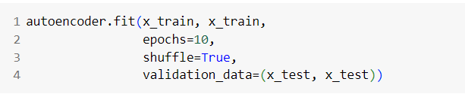
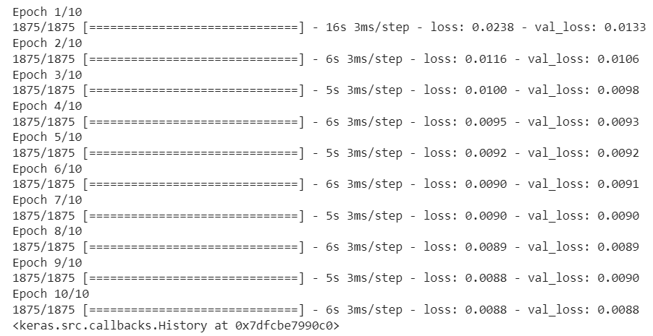
DEMO autoencoder
Basic Autoencoder
Training

Slide 49
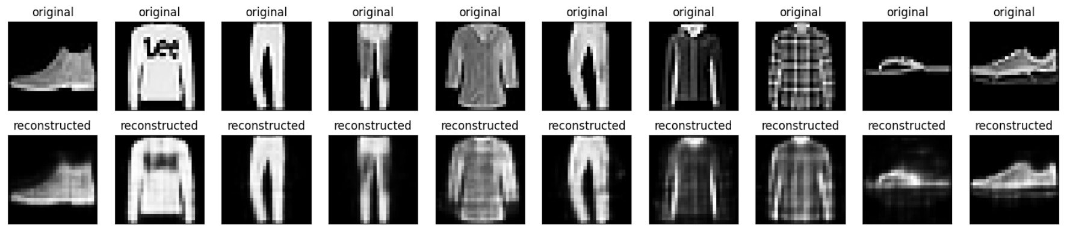
DEMO autoencoder
Basic Autoencoder
Kết quả

Slide 50

DEMO autoencoder
Denoising Autoencoder
Thêm nhiễu vào ảnh

Slide 51

DEMO autoencoder
Denoising Autoencoder
Cấu trúc

Slide 52


DEMO autoencoder
Denoising Autoencoder
Training

Slide 53

DEMO autoencoder
Denoising Autoencoder
Kết quả:

Slide 54
Reference
Afshine Amidi and Shervine Amidi, “Convolution Neural Nets”. [Online]. Available: https://stanford.edu/~shervine/teaching/cs-230/cheatsheet-convolutional-neural-networks [Accessed 25/10/2023]
Hmrishav Bandyopadhyay, “Autoencoders in Deep Learning: Tutorial & Use Cases”, 2023. [Online]. Available : https://www.v7labs.com/blog/autoencoders-guide#what-is-an-autoencoder [Accessed 25/10/2023]

Slide 55
CẢM ƠN THẦY VÀ CÁC BẠN
ĐÃ LẮNG NGHE

